Slide 1
The Kubernetes WebLogic Revival
Martien van den Akker
2019

Slide 2
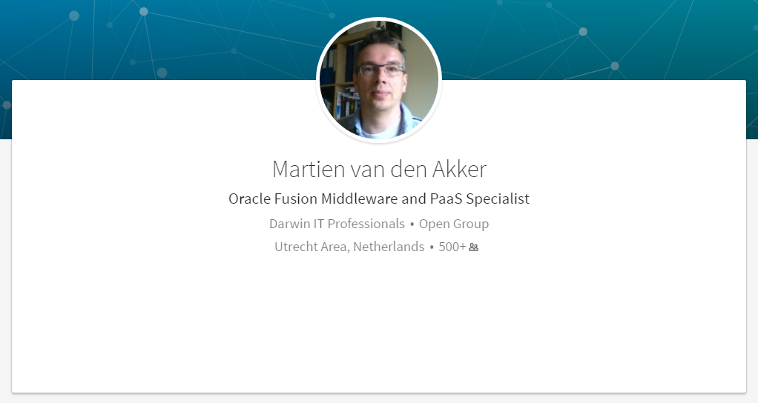
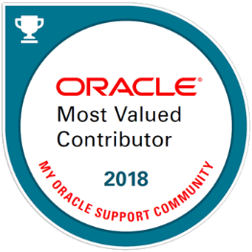

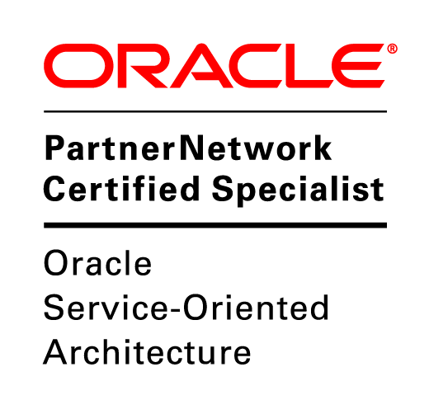




Who I am
martien.van.den.akker@darwin-it.nl
@Makker_nl

Slide 3
Agenda
1
Kubernetes Architecture
Weblogic Operator
HA/DR
Demo
2
3
4
5
6
7
Notes:
3

Slide 4
introduction

Slide 5
Introduction – Why?

Slide 6
Links
My First blog on WebLogic 11g and SAML2
https://blog.darwin-it.nl/2014/04/service-provider-initiated-sso-on.html
Apex, ORDS & ADFS findings on SAML2 and WebLogic 12c:
http://blog.darwin-it.nl/2017/05/single-sign-on-for-apex-with-adfs-with.html
How to redirect URLs for the /saml2 Servlet and /ords/f URI’s
http://blog.darwin-it.nl/2017/05/http-server-redirects-for-WebLogic-12c.html
URL Rewrite to have a ‘nice’ application URL (without /ords/f)
http://blog.darwin-it.nl/2017/06/ohs-url-rewrite.html
A basic one on WebLogic and ADFS
https://blogs.oracle.com/blogbypuneeth/steps-to-configure-saml-sso-with-adfs-as-idp-and-WebLogic-server-as-sp
Publish metadata over URL
https://blog.darwin-it.nl/2018/02/weblogic-12c-saml2-publish-your.html
About weblogic and SHA-1/SHA-256 signing of SAML requests/responses
https://blog.darwin-it.nl/2019/06/weblogic-12213-signs-saml2-requests-and.html

Slide 7
Thank you for your attendance, patience and attention

Slide 8

Q & A

